Slide 1
Welcome to week 2!
What was one fun thing you did over the weekend?
Session 1: Simulation and modeling
Session 2: Building your own drone simulator

Slide 2
Introduction to Simulation and Modeling
Anthony Corso

Slide 3
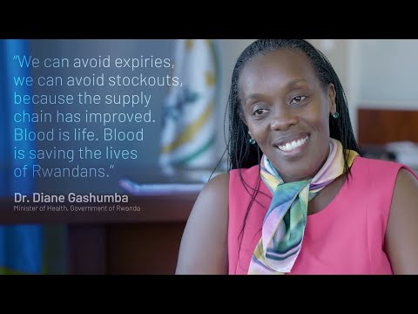

Slide 4
How will we design the zipline control system?
Let’s pretend we are on the zipline team and are responsible for designing the autonomous flight control system
What steps do we take?
Come up with a plan
Implement our idea
Evaluate its performance
The Design Cycle

Slide 5
What are the benefits of designing in the real world?
Simulation may not account for everything in the real world
Personal satisfaction
Existing solutions
Simulations may be more complicated
-> fluid dynamics, soft body robots, weather, complexity
-> Human behavior

Slide 6
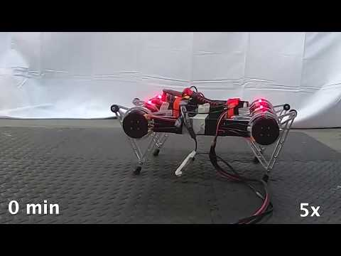

Slide 7
What are the challenges of designing in the real world?
Cost -> Robots are expensive!
Robot can break
Design
Danger to humans
You don’t access to all possible operating conditions
People lose trust in the system if you see it fail
Faster than real time.

Slide 8
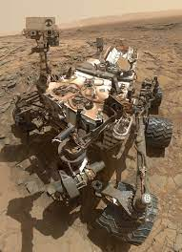
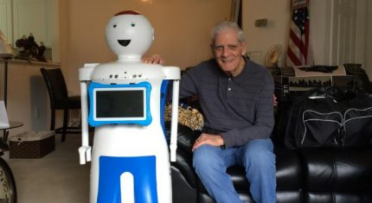
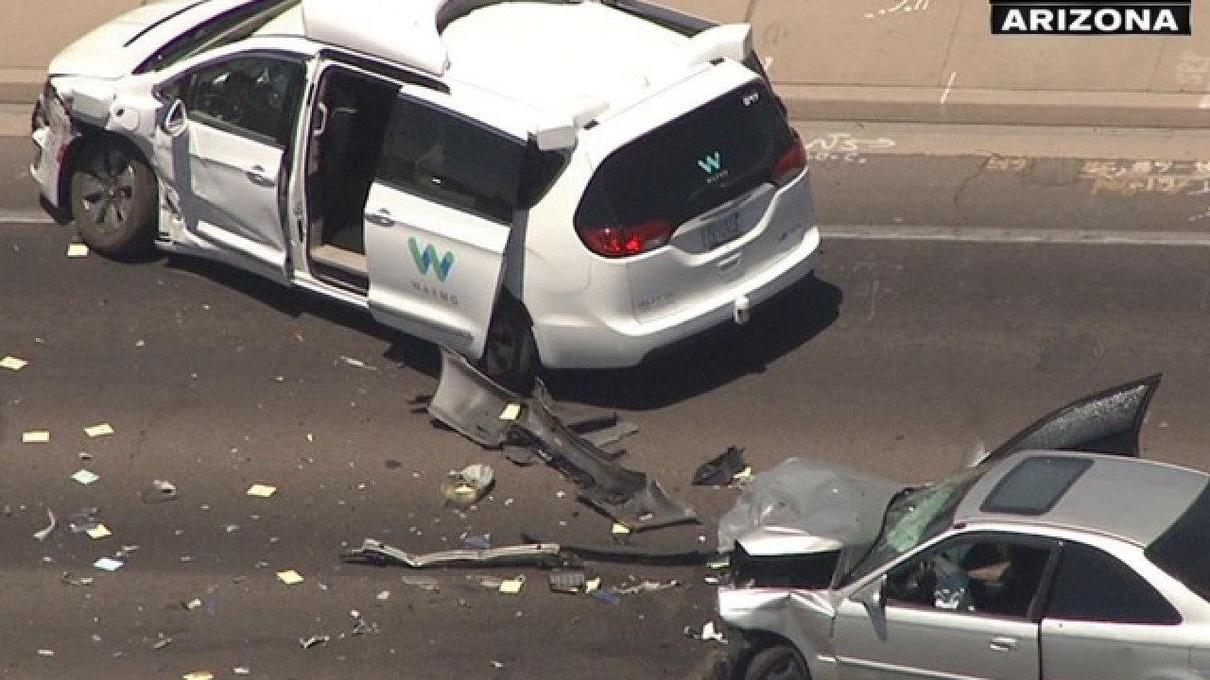

Slide 9
What do we do instead?
Use Modeling and Simulation

Slide 10
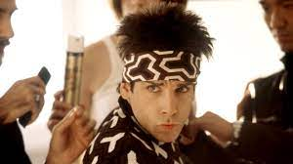
What is modeling and simulation?

Slide 11
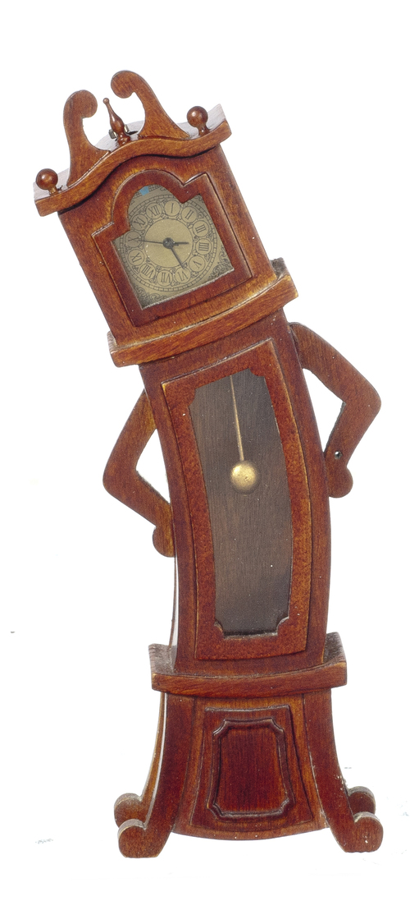
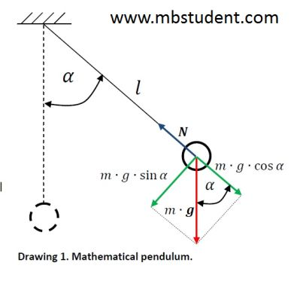
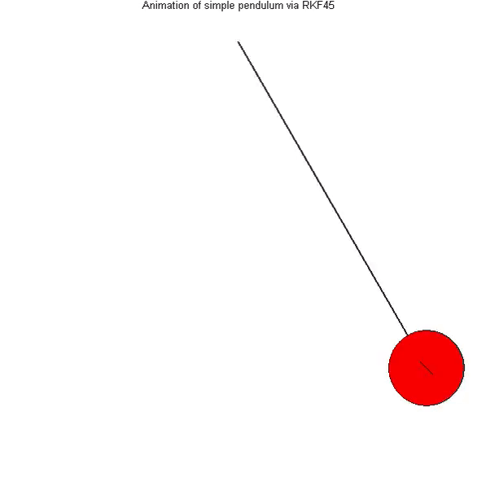
What is modeling and simulation?
Modeling is the process of representing the real world using mathematics.
Simulation uses computers to imitate the real world by running the models.

Slide 12
Simulation Examples

Slide 13
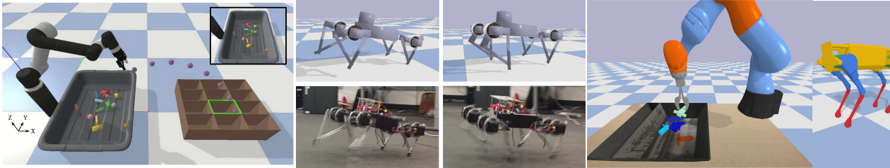
Simulating Robotics
The PyBullet Library

Slide 14
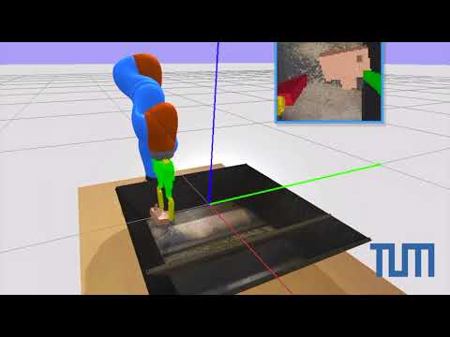

Slide 15
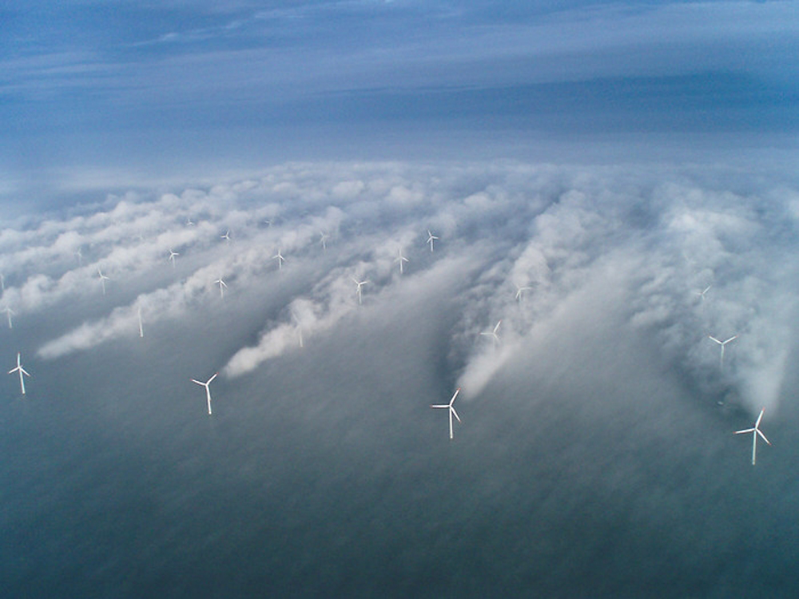

Slide 16
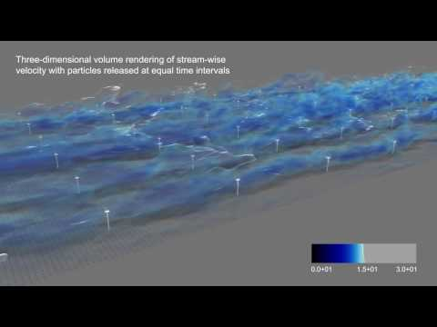
Fluid Flow for wind turbine placement

Slide 17
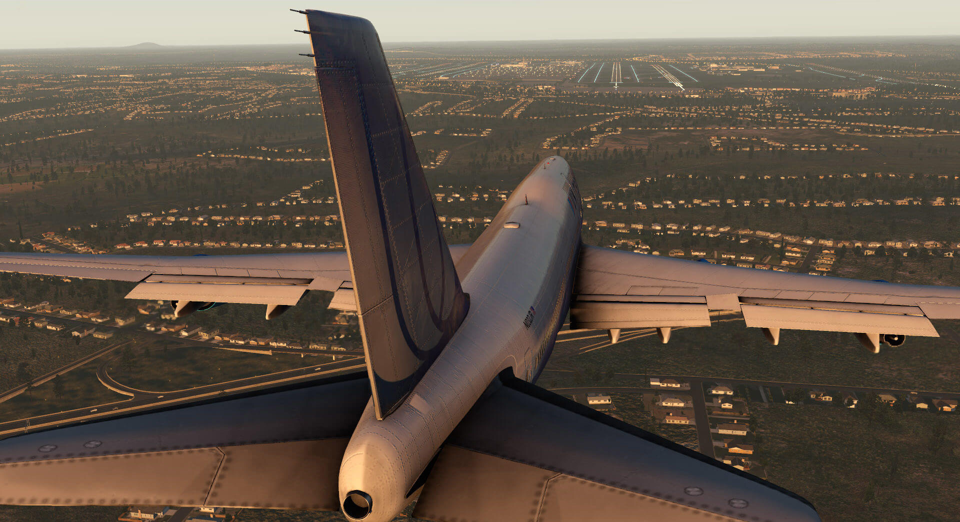
Xplane 11

Slide 18
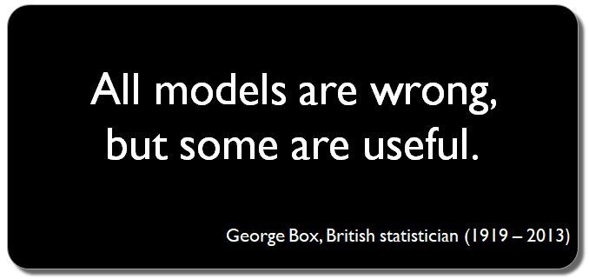
Simulation vs. Reality
If we learned or designed a control policy using a simulator can we use it in the real world?
It depends on how good our model is!

Slide 19
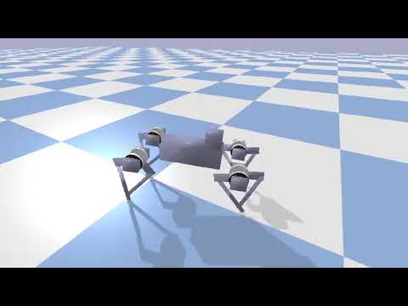

Slide 20
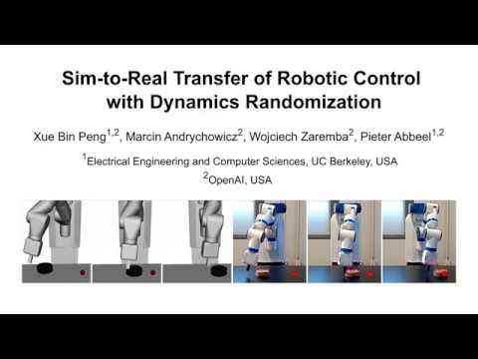

Slide 21
Building our own drone simulator

Slide 22
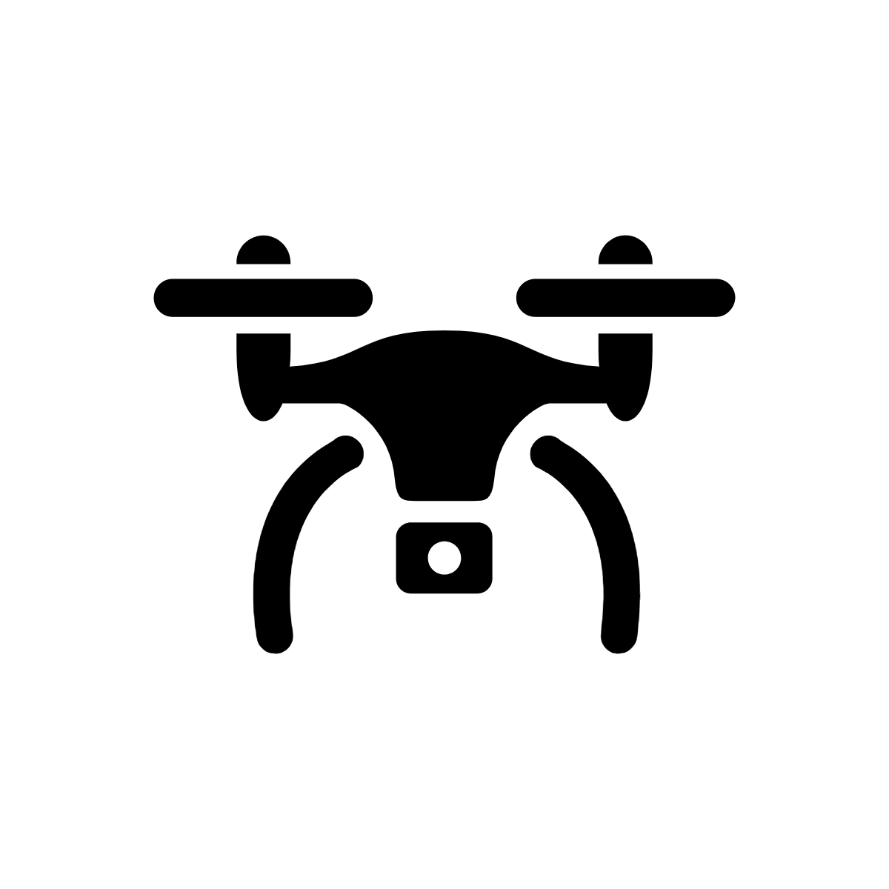
Lets get back to our zipline problem
How do we model this problem?

Slide 23
Modeling a drone
Control Thrust: (Tx, Ty)
How do we put all of this together?
Wind: (Wx, Wy)
State: (x, y, vx, vy)
y-direction
x-direction

Slide 24
The Simulation Loop
Give the state variables starting values
Loop until time reaches the end of the simulation:
Get the thrust values from the controller
Get the wind values (and other disturbances)
Combine into force Fx, Fy
Update the position and velocity values

Slide 25
Updating the position
x = 1 meter
What will be the drone’s position after 1 more second?
vx = 10 m/s
New position = old position + how far it traveled in 1 second
x = x + vx * t
= 1 + 10*1 = 11 meters

Slide 26
Updating the position in 2D
vy = 5 m/s
x = 1 meter
Y = 2 meters
vx = 1 m/s
x = x + vx * t
= 1 + 10*1 = 11 meters
y = y + vy * t
= 2 + 5*1 = 7 meters

Slide 27
Does the drone’s velocity stay constant?
No! It will change based on the “Forces” that are acting on the drone

Slide 28
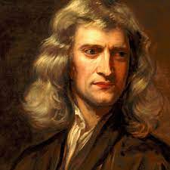
Isaac Newton
Born 1642 and died 1726
Laws of motion and gravitation
Built one of the first functional telescopes
Considered one of the father’s of calculus

Slide 29
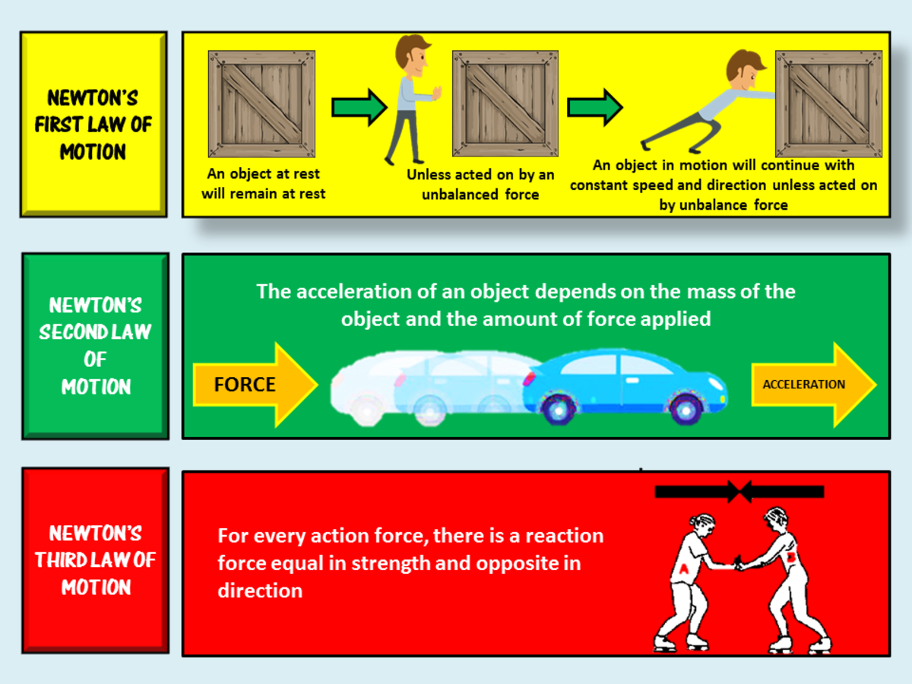

Slide 30
Newton’s Second Law of Motion
F = m*a
Force applied to the drone
Mass of the drone
Acceleration of the drone
a = F/m
Acceleration is the change in velocity over time

Slide 31
Updating the velocity
Fx = 10 N
vx = 10 m/s
m = 1 kg
New velocity = old velocity + change in velocity over 1 second
vx = vx + (Fx / m) * t
= 10 + (10/1)*1 = 20 m/s

Slide 32
All of the equations for our drone
Update position:
x = x + vx * t
y = y + vy * t
Update Velocity:
vx = vx + (Fx / m) * t
vy = vy + (Fy / m) * t

Slide 33
A Note on Python “Classes”

Slide 34
Python Classes
Colab Example
Classes are a way to create new variable types
Recall that previous we had Integers, Floats, Booleans, and Strings
What if we wanted a new variable that represented a student who had a name (string) and an age (Int)?

Slide 35
Building Models with Machine Learning

Slide 36
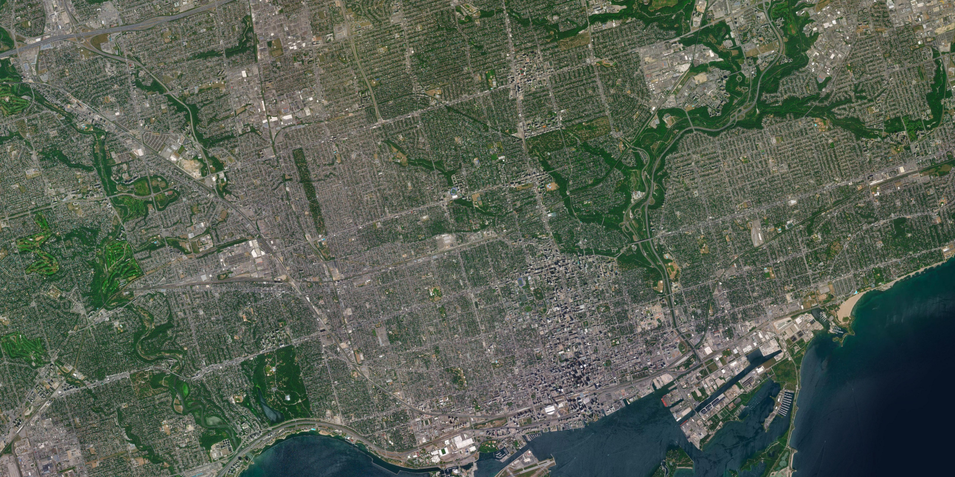

70
60
50
40
30
20
10
10
20
30
40
50
60
70
80
90
100
110
120

